Slide 1

Classificatie en verder …
1984 - 2015
Bert van Hemert
Leids Universitair Medisch Centrum

Slide 2

Disclosure belangen spreker
Disclosure belangen sprekers
(potentiële) belangenverstrengeling | Geen
Voor bijeenkomst mogelijk relevante relaties met bedrijven | -
Sponsoring of onderzoeksgeld Honorarium of andere (financiële) vergoeding Aandeelhouder Andere relatie, namelijk … | - - - Rivierduinen, Parnassia Groep, VUMC, UMCG, EUR, CHDR, Curium

Slide 3

Persoonlijke ontwikkeling
1959
1977
1984
1994
2012
Geboren
Geneeskunde
Afgestudeerd
Epidemiologie
Psychiatrie
Afdelingshoofd LUMC

Slide 4
Ontwikkelingen in de Psychiatrie
1959
1977
1984
1994
2012
Geboren
Geneeskunde
Afgestudeerd
Epidemiologie
Psychiatrie
Afdelingshoofd LUMC
1959
1968
1972
1978
1980
1994
2013
Hempel
Spraakverwarring
Feighner
Spitzer – RDC
DSM-III
DSM-IV
DSM-5

Slide 5
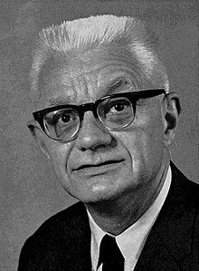
1959 Fundamentals of Taxonomy
Carl Gustav Hempel (1905 – 1997)
Wetenschapstheorie – Logisch positivisme
Belang van operationele definitie van wetenschappelijk terminologie
Beschrijving
Theoretische Systematizering
World Conferenence on Field Studies in the Mental Disorders, New York 1959

Slide 6
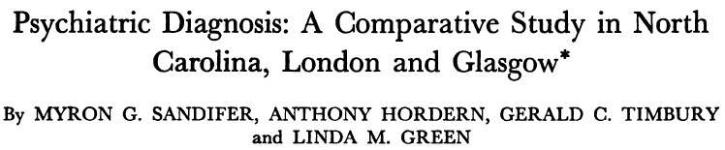


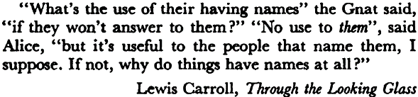
1968 - Taal voor diagnostiek
Functionele psychosen Manisch-depressieve psychose

Slide 7
1972-1978 Diagnostic Criteria
Feighner 1972 | Spitzer 1978
Schizofrenie | Schizofrenie
 | Schizo-affectieve stoornis
 | Bipolaire stoornis
Primaire affectieve stoornis | Depressieve stoornis
Secondaire affectieve stoornis
Angstneurose | Gegeneralsieerde angststoornis
 | Paniekstoornis
Obsessief Compulsieve Neurose | Obessieve Compulsieve stoornis
Fobische neurose | Fobie
Hysterie | Somatizatie stoornis
Antisociale persoonlijkheid | Antisociale persoonlijkheid
 | Cyclothyme persoonlijkheid
 | Labiele persoonlijkheid
Alcoholisme | Alcoholisme
Drugs afhankelijkheid | Drugs afhankelijkheid
 | Schizotypische trekken
Anorexia Nervosa
Mentale retardatie
Homosexualiteit
Transsexualiteit
Feighner e.a: 14
Spitzer e.a : 15
Feighner JP, Robins E, Guze SB, Woodruff RA, Winokur G, Munoz R. Diagnostic criteria for use in psychiatric research. Archives of General Psychiatry 1972; 26: 57-63.
Spitzer RL, Robins E (1978). Research diagnostic criteria: rationale and reliability. Archives of General Psychiatry 1978; 35: 773-82.

Slide 8
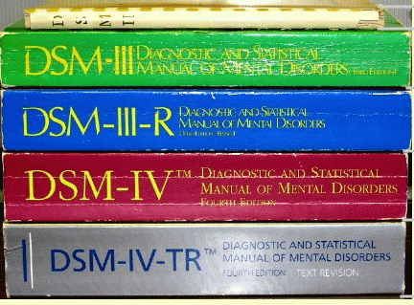

Diagnostic and Statistical Manual
1952
1968
1980
1994
2013 – NL: 2014

Slide 9
1960 – 1994 Hospital and Community Psychiatrye
Hennessy KD, Greenberg RP. Four decades of mental health trends: an empirical analysis of Hospital and Community Psychiatry. Hosp Community Psychiatry 1994;45:1034-9.

Slide 10

Explosieve groei van empirische kennis
Epidemiologie
Klinische trials
    Medicatie
    Psychotherapie
  Evidence based multidisciplinaire richtlijnen voor alle grote ziektebeelden

Slide 11


Slide 12








2012 “Schandalige” DSM-5

Slide 13
1959 Fundamentals of Taxonomy
Carl Gustav Hempel (1905 – 1997)
Wetenschapstheorie – Logisch positivisme
Belang van operationele definitie van wetenschappelijk terminologie
Beschrijving
Theoretische Systematizering
World Conferenence on Field Studies in the Mental Disorders, New York 1959

Slide 14
Symptomen van angst en depressie

Slide 15
Chronische depressie

Slide 16
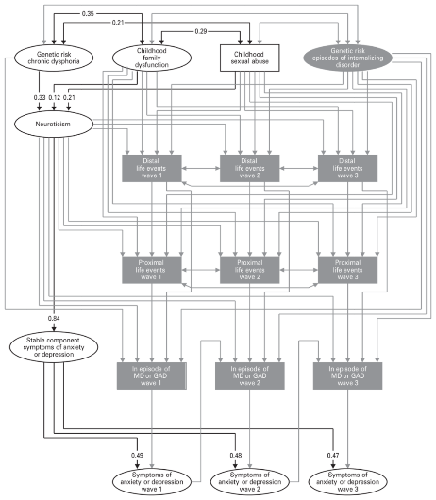
Model of pathways twin study
2395 female twins
Genetic risk
Early adversities
Three wave study
Neurotcism
Episodes AnxDep
Symptoms AnxDep
Kendler et al., 2011, Psychol Med
/ 35

Slide 17
Two etiologic pathways
Early events
Genetic
Neuro-ticism
Life events
Stable AnxDep
Episode AnxDep
Symptoms AnxDep
/ 35

Slide 18

Retrospective reports of childhood abuse
Netherlands Study of Depression and Anxiety (NESDA, n=2981)
10-year longitudinal controlled community study in adults
Childhood Abuse | Controls (n = 498) | Anx Dep disorder (n = 2288) | Odds Ratio
Emotional Neglect | 19% | 45% | 3.54
Psychological Abuse | 11% | 29% | 3.25
Physical Abuse | 6% | 16% | 2.79
Sexual Abuse | 13% | 21% | 1.79
Spinhoven, Elzinga e.a., 2010, Journal of Affective Disorders
/ 35
Notes:
Difficult to get good prevalence rates. Large epidemiological studies that have been conducted among adults generally rely on self-report, with associated difficulties regarding the validity of retrospective reports. Problems include simple forgetting, nonawareness, nondisclosure and reporting biases because of mood states.
The prevalence numbvers are derived from the NESDA. Few striking findings; Emo en negelct most prevalent. Important to note here that
Retrospective design problematic, but number are cnsistent with studies in children that rely on interviews with professionals.
on the However, a recent meta-analysis of studies using external corroboration of self-reports revealed that false negatives are more frequent than false positives, leading to downward biases in estimated associations between early adversity and outcome variables
Nevertheless, some aspects tend to be replicated again and again. and that is that the prevalence of CA is rather high, and much higher than official estimates, and that these experiences are generally more prevalent in those having a depression or anxiety disorder, and also that emo abuse and neglect most prevalent type of CA.

Slide 19
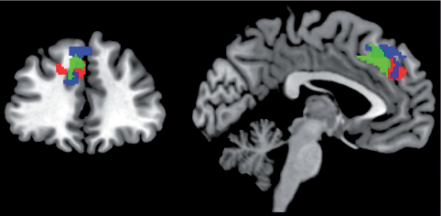
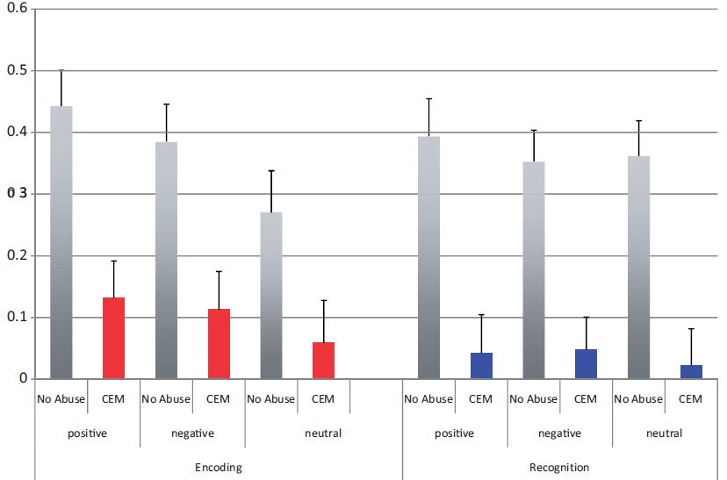
Reduced activation in mPFC in individuals with reported history of emotional maltreatment
POSITIVE
NEGATIVE
NEUTRAL
POSITIVE
NEGATIVE
NEUTRAL
ENCODING
RECOGNITION
► Pattern consistently observed in patients and healthy controls
► Not explained by psychopathology, gender, nor neuroticism or recent life events
Van Harmelen, van Tol et al., 2014, SCAN
/ 35

Slide 20
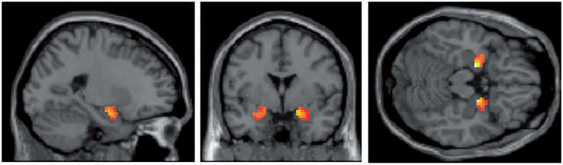
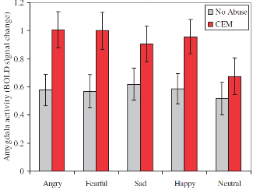
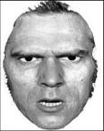
Amygdala response to faces ↑ in individuals with reported history of emotional maltreatment
*
*
*
► Pattern consistently observed in patients and healthy controls
► Not explained by psychopathology, gender, nor neuroticism or recent life events
Van Harmelen, van Tol et al., 2013, SCAN
/ 35
Notes:
Very basic: first results are results from a task were participants had to look at faces with different facial expressions, ranging from angry, fearful, sad, happy, and neutral.

Slide 21

Onderzoeksagenda GGZ
Ontwikkelen van strategieën voor vroegdetectie en vroeginterventie
Ontwikkelen van gepersonaliseerde GGZ

Slide 22
